Slide 1







ENGLISH YEAR 3
MODULE 2- EVERY DAY

Slide 2





LEARNING OBJECTIVES
By the end of the lesson, pupils will be able to:
Understand with support, specific information and details of short simple texts.
Guess the meaning of unfamiliar words by using visual clues when a teacher or classmate is speaking.

Slide 3


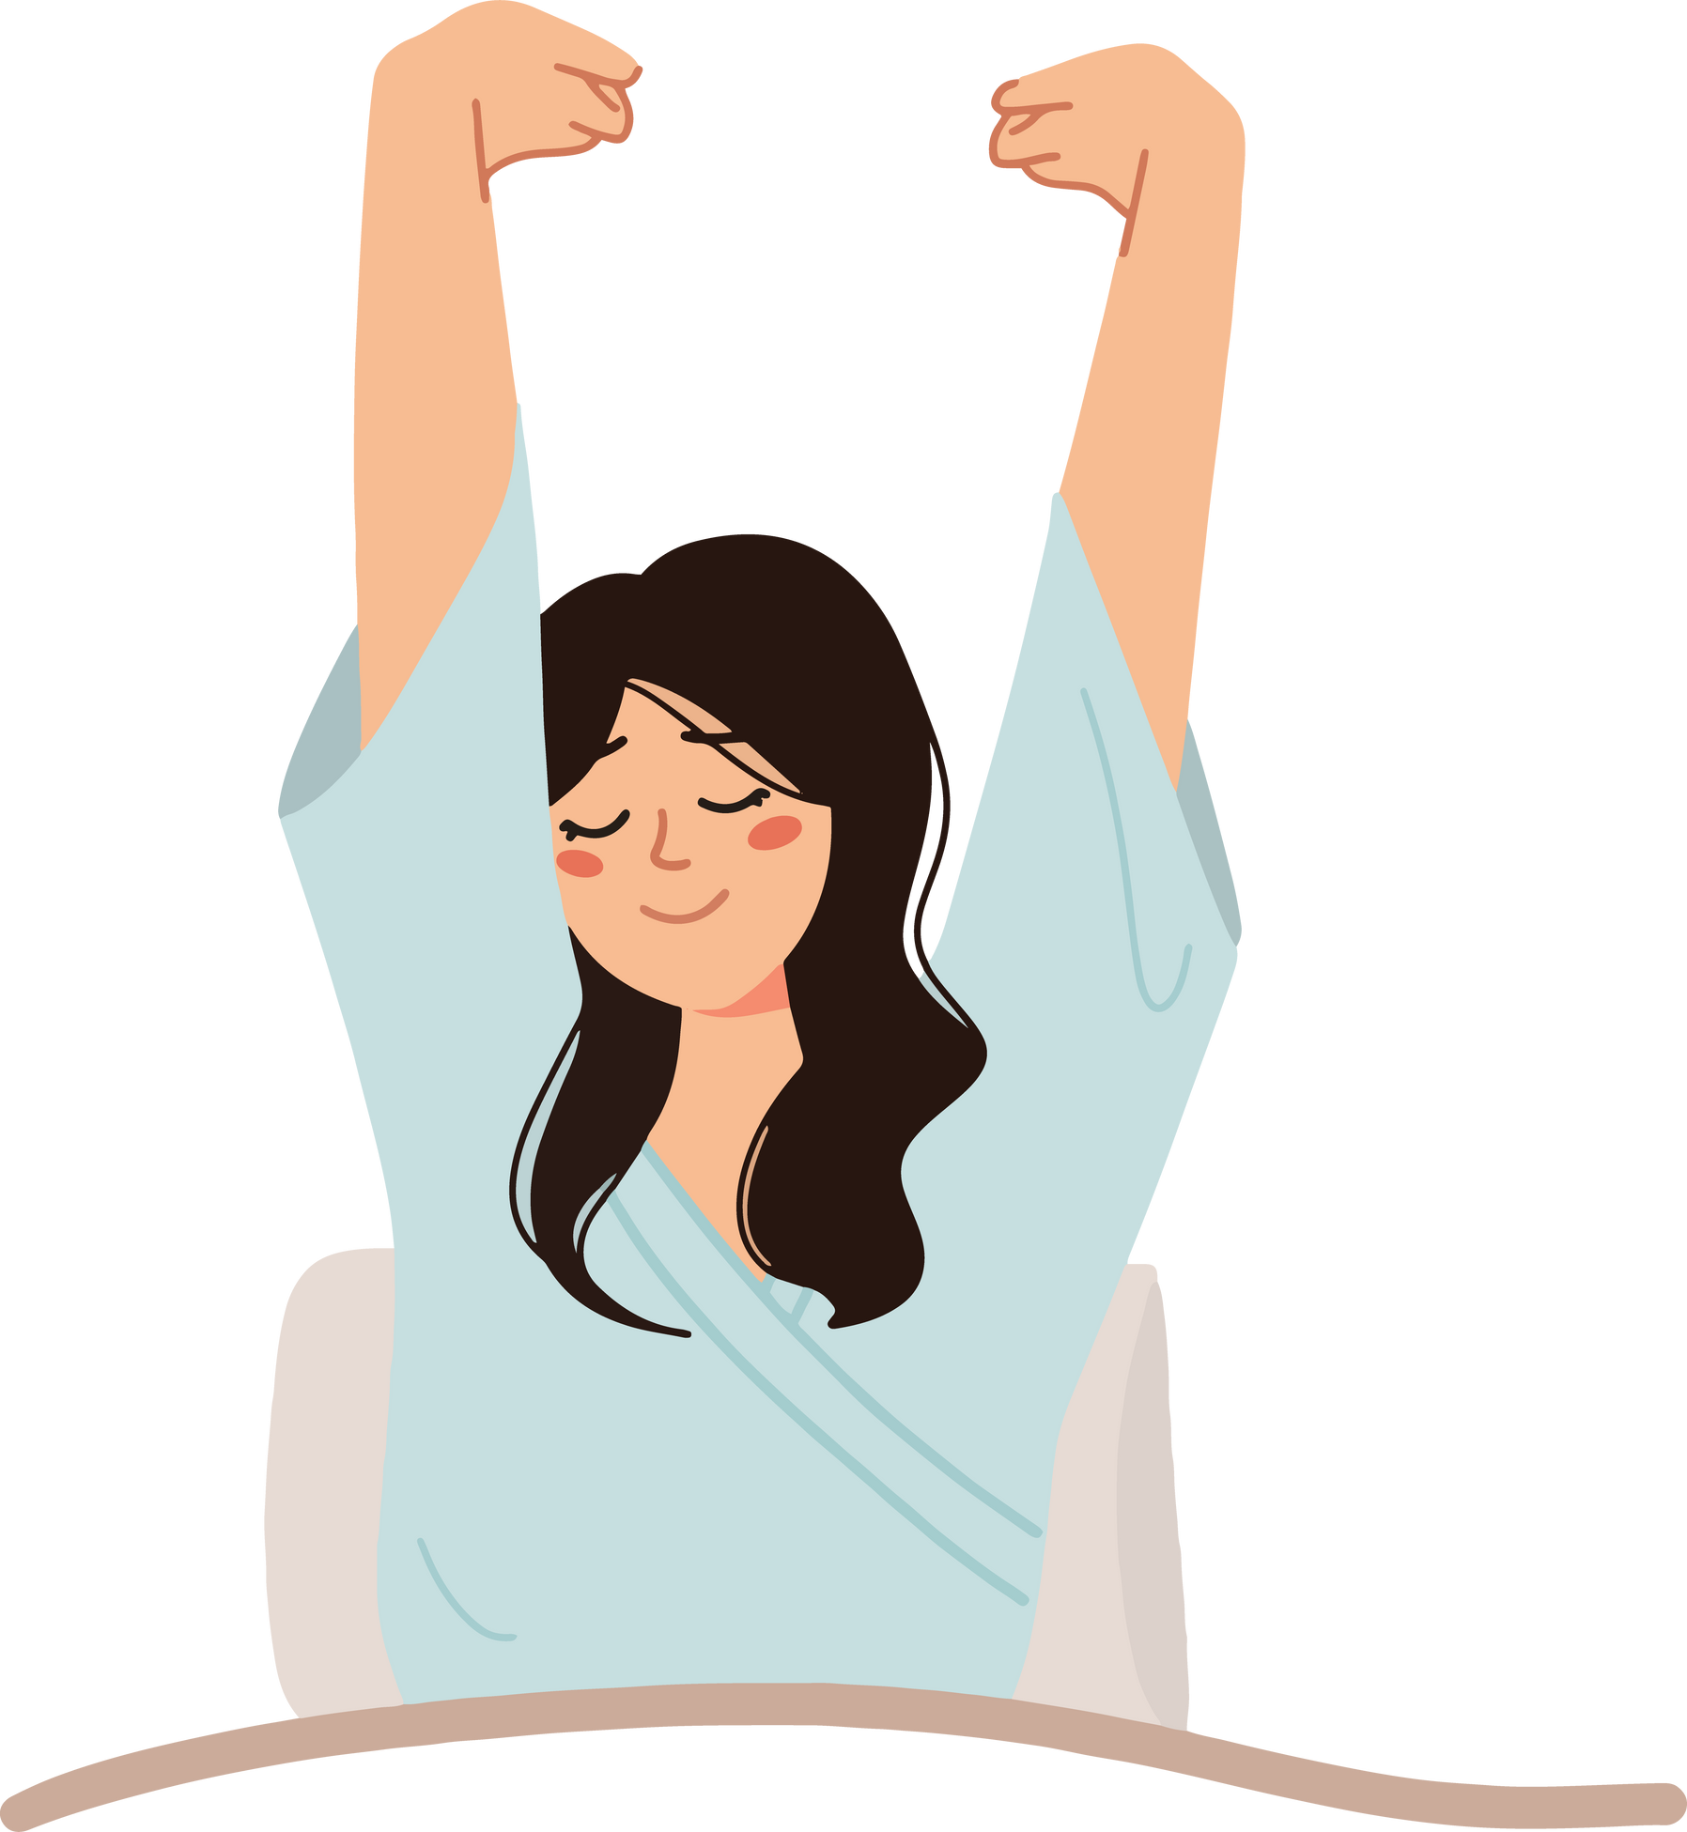


WHAT IS SHE DOING?

Slide 4



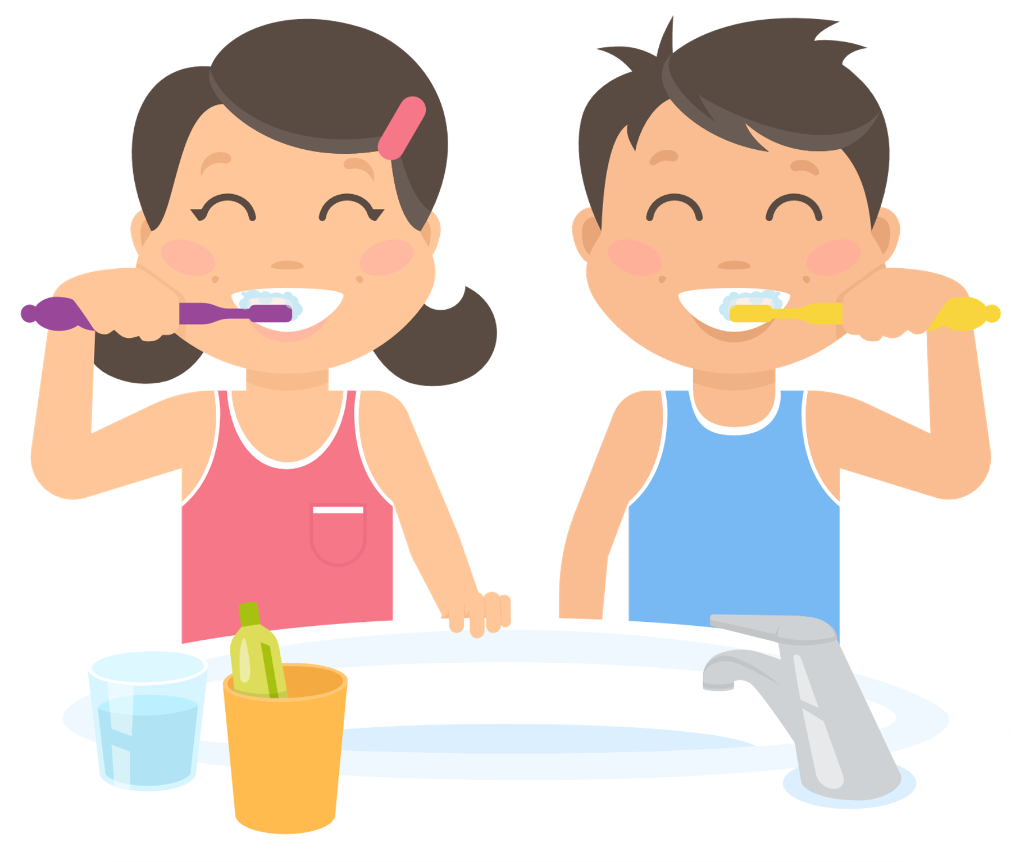
LET'S LOOK AT SOME DAILY ROUTINES
Waking up in the morning
Taking a shower
Brushing teeth

Slide 5
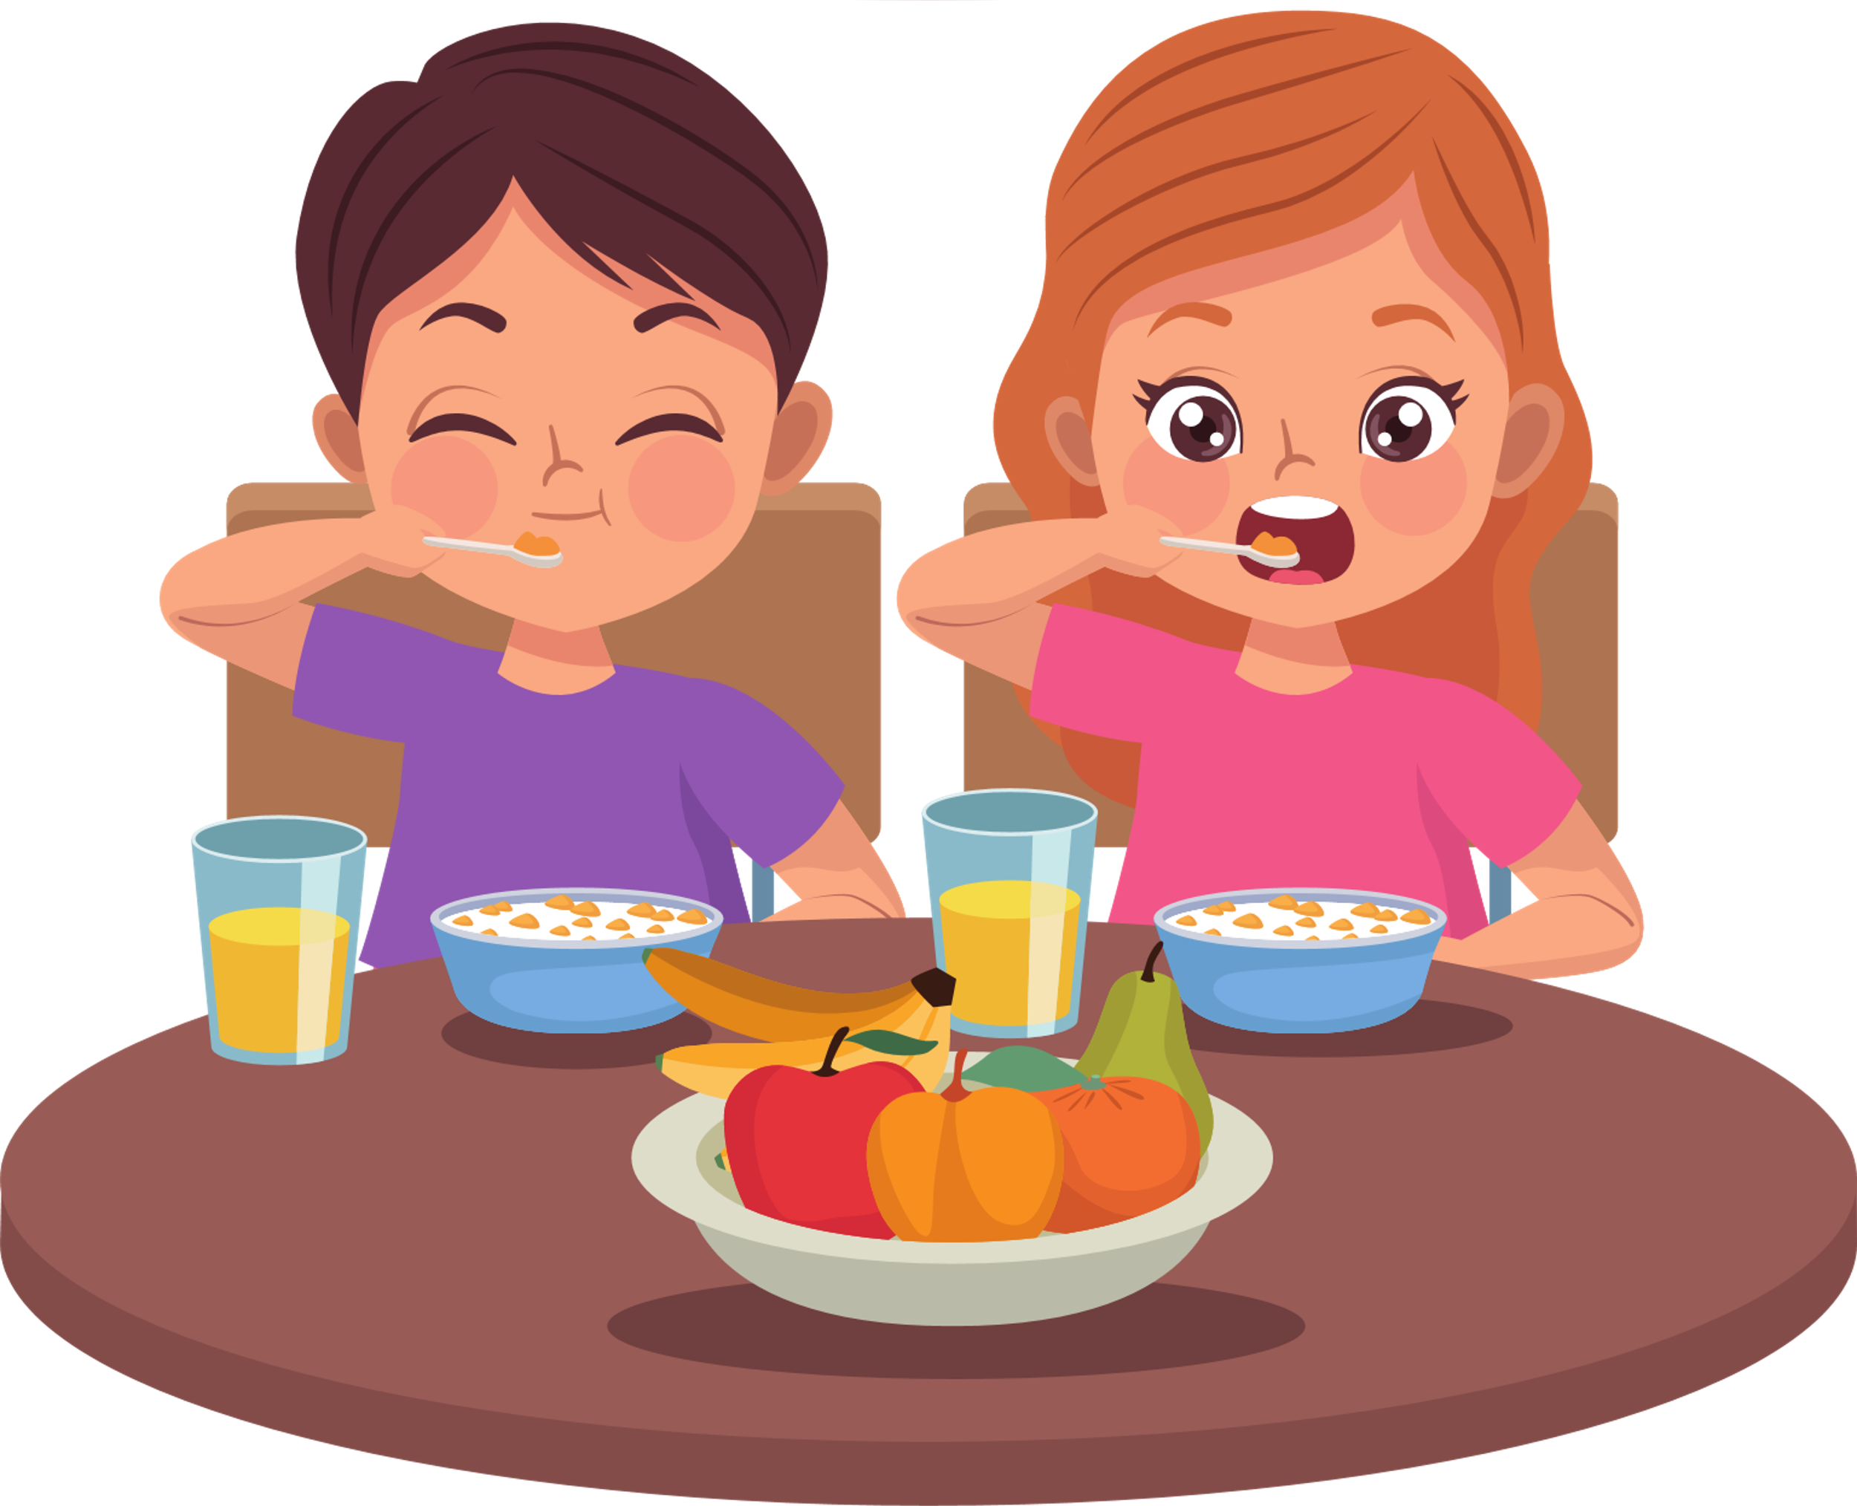


LET'S LOOK AT SOME DAILY ROUTINES
Eating breakfast
Walking to school
Studying

Slide 6

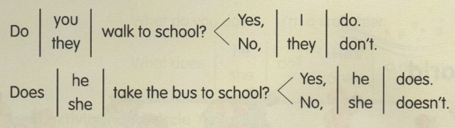

HOW TO ASK QUESTIONS WITH SIMPLE PRESENT TENSES

Slide 7


SHARING SESSION
Take turns asking and sharing with your friend your daily routines.
Use the correct tenses while talking about your day.

Slide 8


YOU!
THANK

